Slide 1
A computational investigation of pathogen transport, evaporation, and deposition originating from synthetic human coughs and breathing
CARES Act “Viral Fate and Transport” Project Closeout
February, 24th, 2021
Stefan P. Domino
*Computational Thermal and Fluid Mechanics (1541)
Sandia National Laboratories SAND2021-1118 O

Slide 2
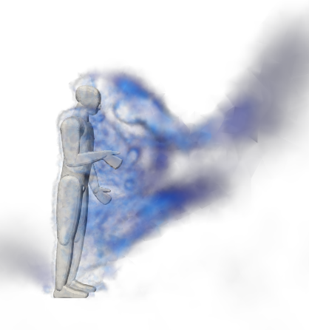
Objectives
Overview of Infection Pathways, Transmission, Viability, and Masks
Physics Description of Coughs, Sneezes, and Breathing
Model Suite: Multi-physics Eulerian/point-Lagrangian Approach
High Performance Computing drivers
Established Code Credibility
Case Study:
Coughs/breathing with and without protective shields
Coughs in open spaces with probability of infection link
Conclusions
https://grabcad.com/dhanasekar.vinayagamoorthy-1

Slide 3
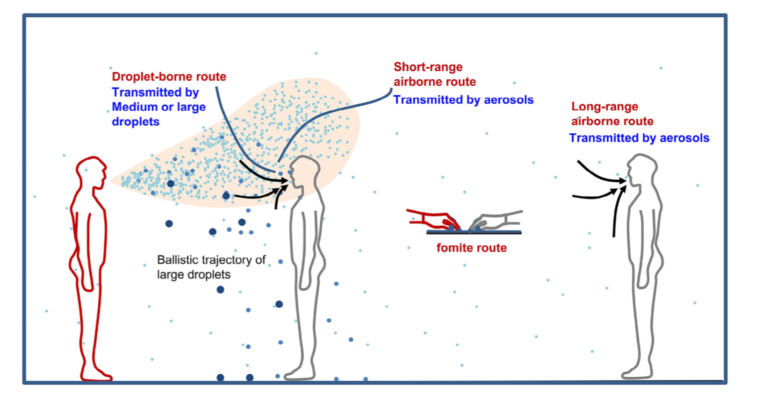
Pathogen Transport and Infection Mechanisms
Direct and Indirect transmission mechanism: 2’, 6’, 10’, …, social distance guideline to follow?
A note on research motivation: Early in the pandemic, the open news cycle was not distinguishing between fluid mechanics transport of droplets emanating from a cough/sneeze and the likelihood of infection by either direct or indirect transmission
Not alone at SNL, e.g., Cliff Ho (8820) COVID-19 LDRD
As fluid mechanists, we can provide leadership towards answering the former while partnering with those who can speak towards pathogen viability and infection probabilities by providing detailed time-history trajectories
Wei and Li, A. J. Infec. Cont., 2016

Slide 4
SARS-CoV-2 Transmission: A Recent Review
“Transmission of SARS-CoV-2: A Review of Viral, Host, and Environmental Factors”, Meyerowitz et al., Annals of Internal Medicine, 2020.
Respiratory transmission: “The dominant route of transmission of SARS-CoV-2 is respiratory. Growing evidence indicates that the infectious virus can be found in aerosols and in exhaled breath samples.”
Direct Contact and Fomite: “There is currently no conclusive evidence for fomite or direct contact transmission of SARS-CoV-2 in humans.”
Domestic Pets and Farm Animals: No evidence.
Vertical Transmission: Limited infant infection; no confirmed cases of infants infected by breast milk. “Vertical transmission of SARS-CoV-2 rarely occurs”.
Fecal-Oral (or Fecal Aerosol): Low chance – even from aerosols emitted from flushing toilets. (good news for car trips).
Sexual Transmission: No current evidence supports this mode.
Bloodborne Transmission: No documented case of bloodborne transmission, although 32.9% patients displaying symptoms were found to have viral RNA while 3/307 for general blood samples.

Slide 5
Viability of SARS-CoV-2 Aerosols
“Aerosol and Surface Stability of SARS-CoV-2 as Compared with SARS-CoV-1”, van Doremalen et al., New England Journal of Medicine, April 16, 2020.
Excerpts: (modified/curtailed):
The half-lives of SARS-CoV-2 and SARS-CoV-1 were similar in aerosols, with median estimates of approximately 1.1 to 1.2 hours
Stability of SARS-CoV-2 was similar to that of SARS-CoV-1 under the experimental circumstances tested.
Differences in the epidemiologic characteristics of these viruses probably arise due to higher viral loads in the upper respiratory tract and the potential for persons infected with SARS-CoV-2 to shed and transmit the virus while asymptomatic.^{3,4}
Our results indicate that aerosol and fomite transmission of SARS-CoV-2 is plausible, since the virus can remain viable and infectious in aerosols for hours and on surfaces up to days (depending on the inoculum shed).
Image from van Doremalen et al., NEJM, 2020

Slide 6
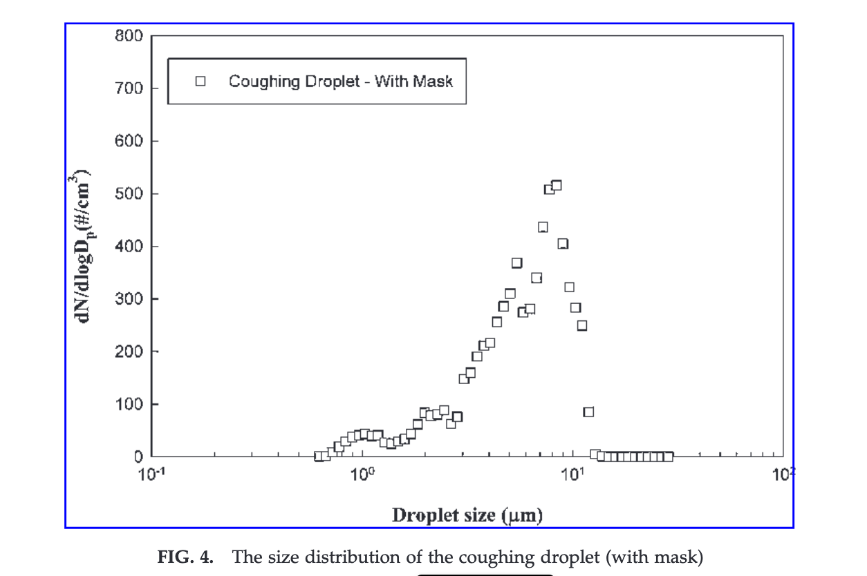
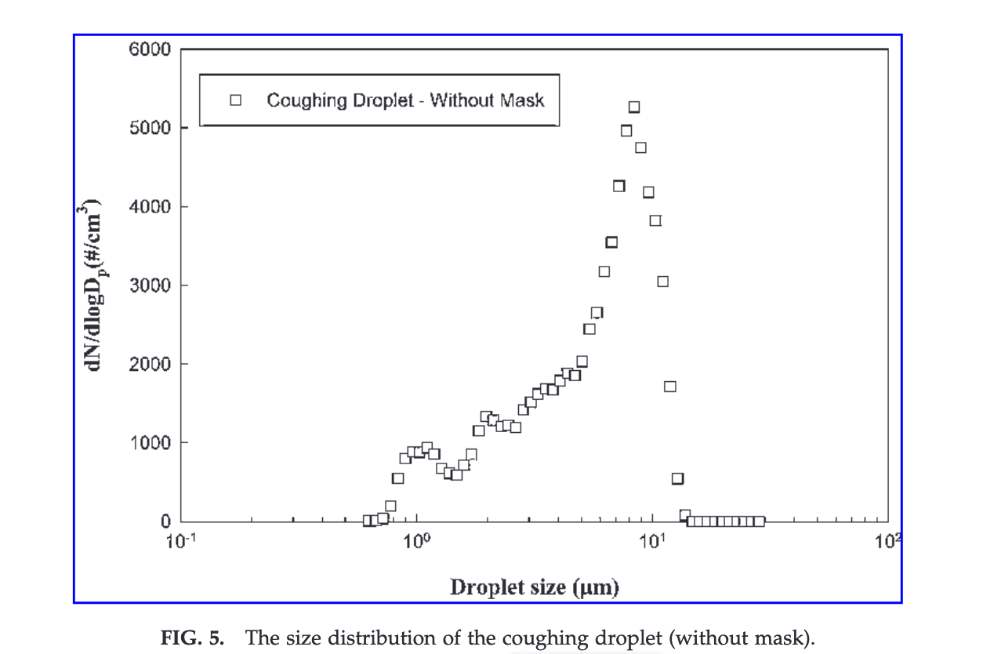
The Role of Masks in Droplet/Transmission Suppression
“The size and concentration of droplets generated by coughing in human subjects”, Yang et al., J. of Aerosol Medicine, 20(4), 2007
Key Findings:
Size distribution with and without mask: Insignificant
Total number of droplets with and without mask: Significant
Variation of droplet concentration based on Male/Female: Significant
2.65 meters = 8’ 8”
Yang et al., J of Aerosol Medicine, 20(4), 2007.
Notes:
P100 filters droplets 3 micron and larger

Slide 7
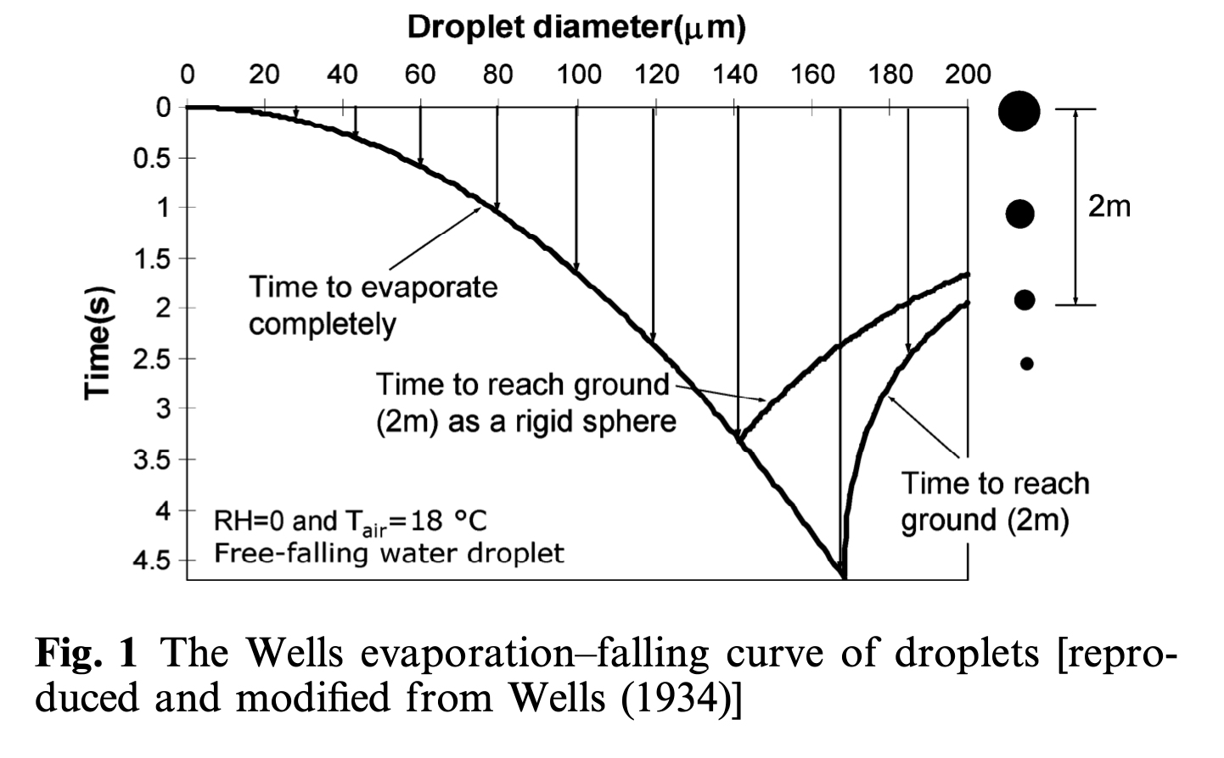
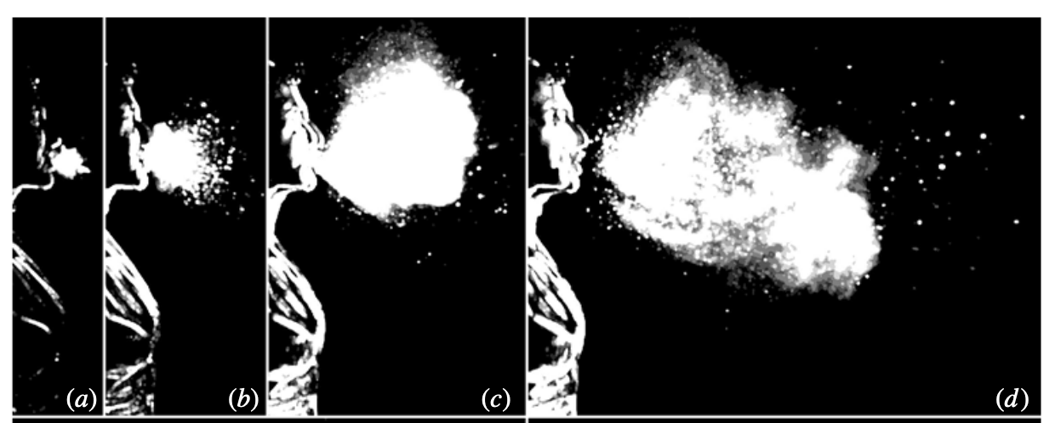
A Brief View on Pre-COVID-19 Distance Guidelines
“On air-borne infection. Study II. Droplets and droplet nuclei”, Wells, W.F., Am. J. Hyg., 20, 1934
2 meter/six foot guideline established with rudimental models (possibly based on experiments and/or extrapolation) in absence of physics such as surrounding air, carrier gas, humidity, and salinity
“How far droplets can move in indoor environments – revisiting the Wells evaporation –falling curve”, Xi et al., Indoor Air, 17, 2007
One of the first studies to include a carrier gas (jet/cough)
Sneezing (50 m/s) > 6 m; Coughing (10 m/s) > 2 m; Breathing (1 m/s) < 1 m
“Violent expiratory events: on coughing and sneezing”, Bourouiba et al., JFM (2014)
Sounds the alarm linking coughs and sneezes to long transport distances, i.e., > 6 m
(73 years later)
2.65 meters = 8’ 8”
Xi et al., 2007
Bourouiba et al., 2014

Slide 8
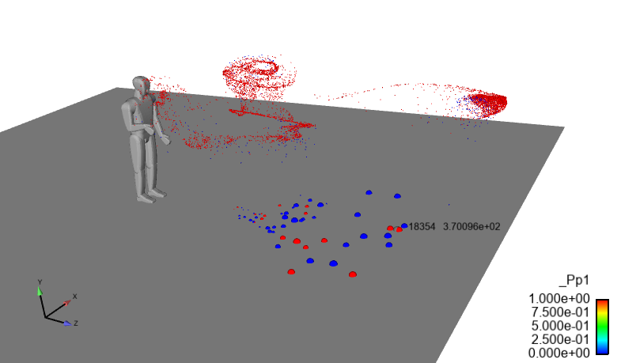
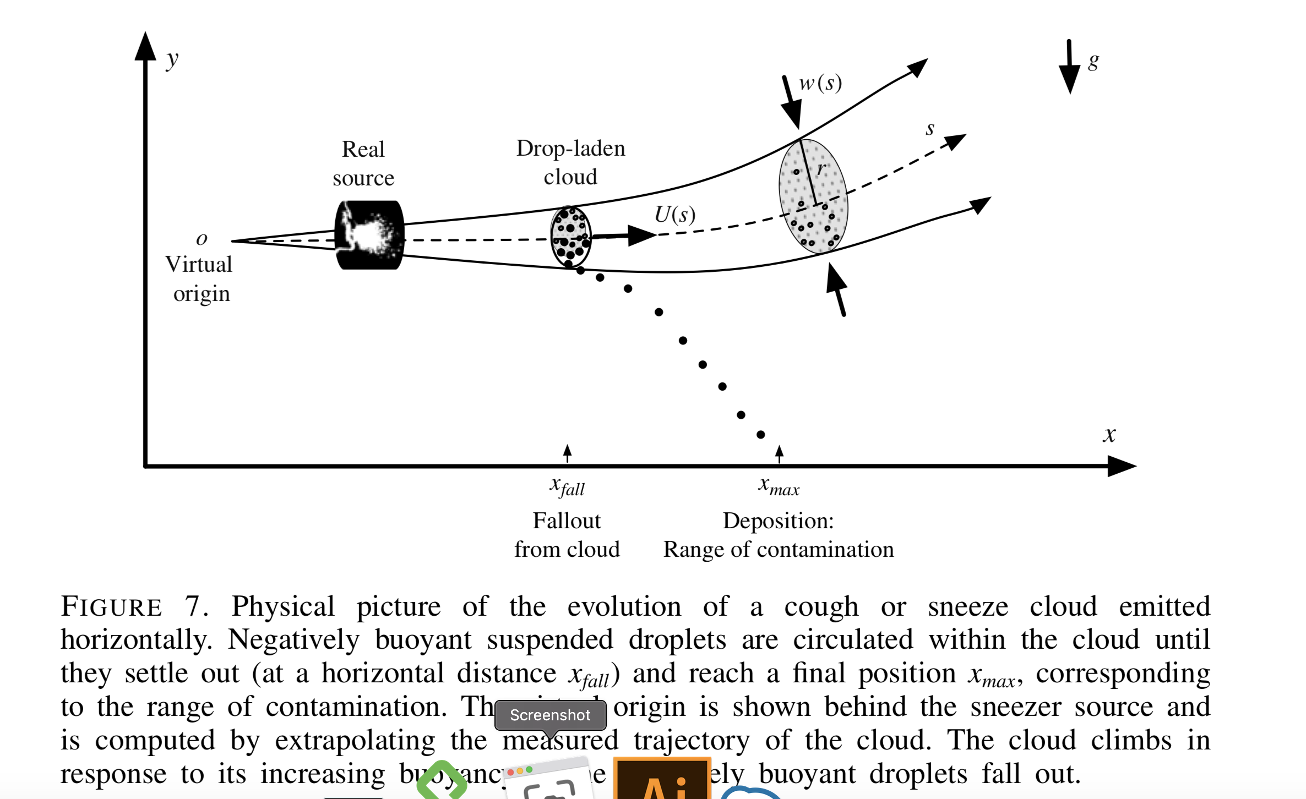
Objective: Modeling Droplets from Human Coughs in Complex Environments with a Link to Probability of Infection
First: Establish a credible, multi-physics mod/sim capability to understand droplet deposition and pathogen transport originating from synthetic human coughs/breathing
Sandia Rapid LDRD
Second, Drive a science-based approach to understand airborne transmission with probability of infection COVID-19 estimates in common public space use-cases
CARES Act
Coughs are turbulent buoyant, multiphase plumes (Re~10-20K for coughs; easily double for sneezes)
Evaporation rates, which are environment-specific, provides understanding towards what droplets deposit and those that persists
Droplet nuclei, i.e., pathogen-containing small (~5 μm) particles, now in aerosol form can persist in the environment and may pose a long term risk to occupants
Bourouiba et al, JFM, 2014
Fuego synthetic sneeze sim with droplet distribution from Yang et al, J. Aerosol Med, 2007 including pathogen probability
(1 m/s streamwise wind)
Ultimate Objective: Link dose-response (probability of infection) to high-fidelity CFD

Slide 9
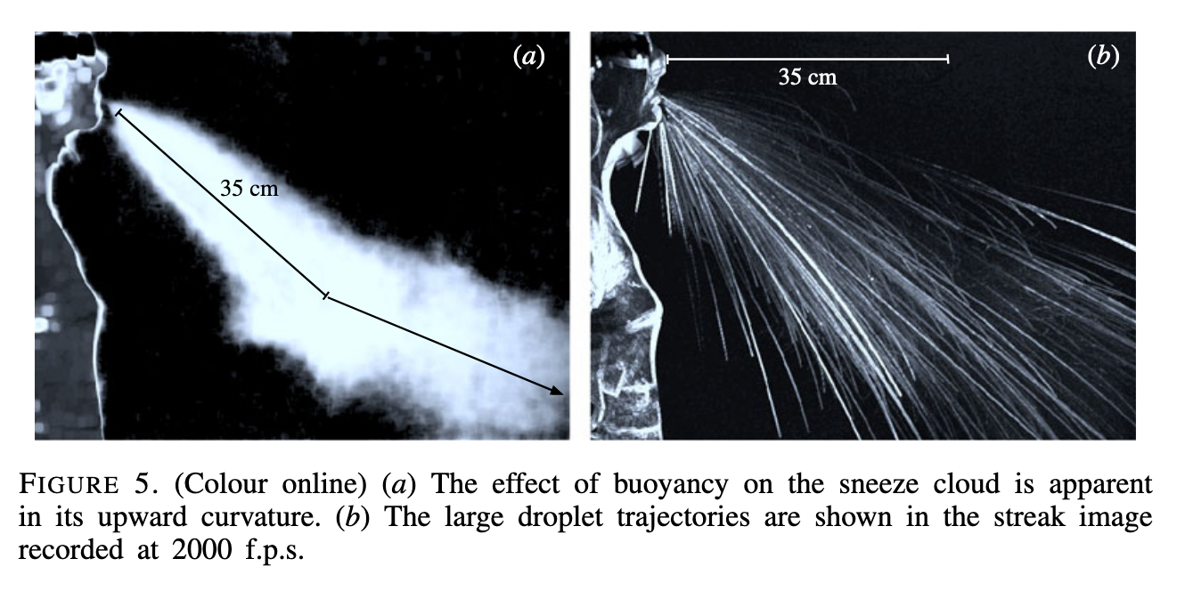
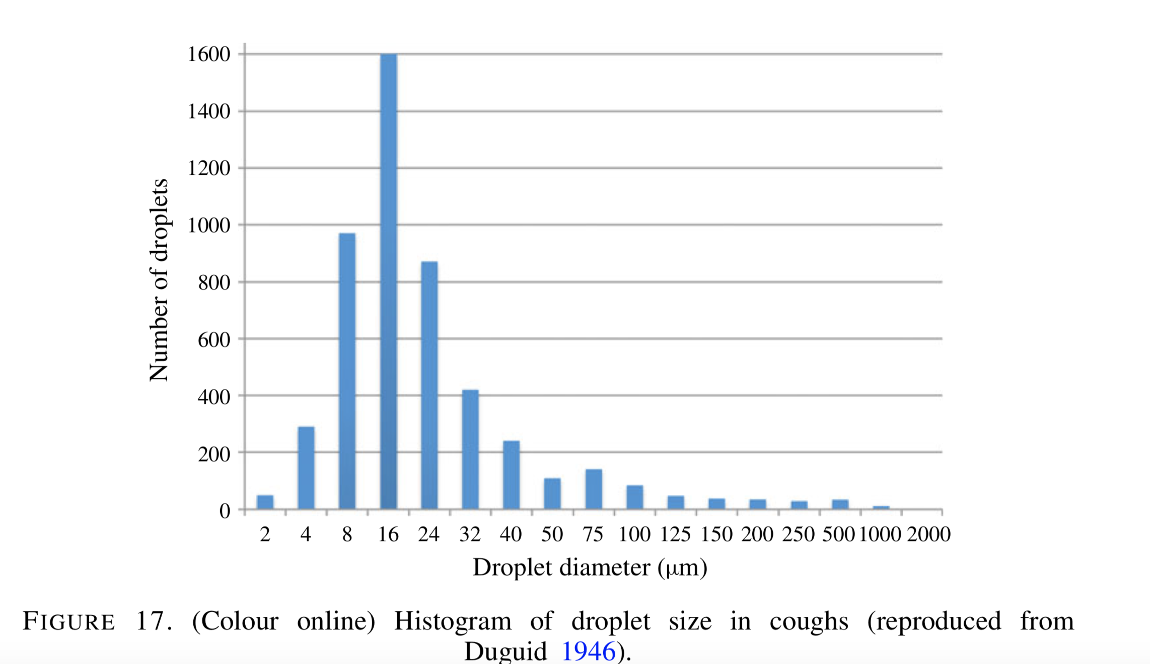
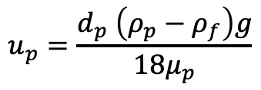
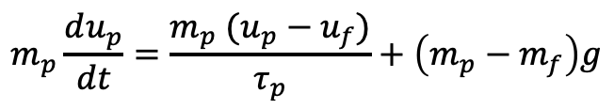
Droplet Size Distribution; Settling Speed; Buoyancy Effects
Size, number and cough velocity are well characterized starting from as early as 1946
Variability in the literature exists
low-Stokes# Settling Speed:
Buoyancy, which affects plume dynamics, are known to be significant factors
1 cough = talking for five minutes
Modest room ventilation can easily suspend a droplet nuclei
Droplet Size (μm) | Settling Velocity (cm/s) | Settling Time for 2m height (s) | Evaporation Time (s)
100 | ~30 | ~6.6 | ~7
1 | ~3e-3 | ~66e3 (18.5 hr) | ~7e-4
$$m_{p}\frac{du_{p}}{dt}=\frac{m_{p} (u_{p}−u_{f})}{τ_{p}}+\left(m_{p}−m_{f}\right)g$$
$$u_{p}=\frac{d_{p} \left(ρ_{p}−ρ_{f}\right)g}{18μ_{p}}$$
Figures/Images provided by Bourouiba et al., JFM, 2014

Slide 10
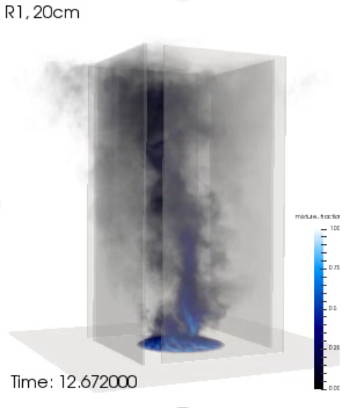
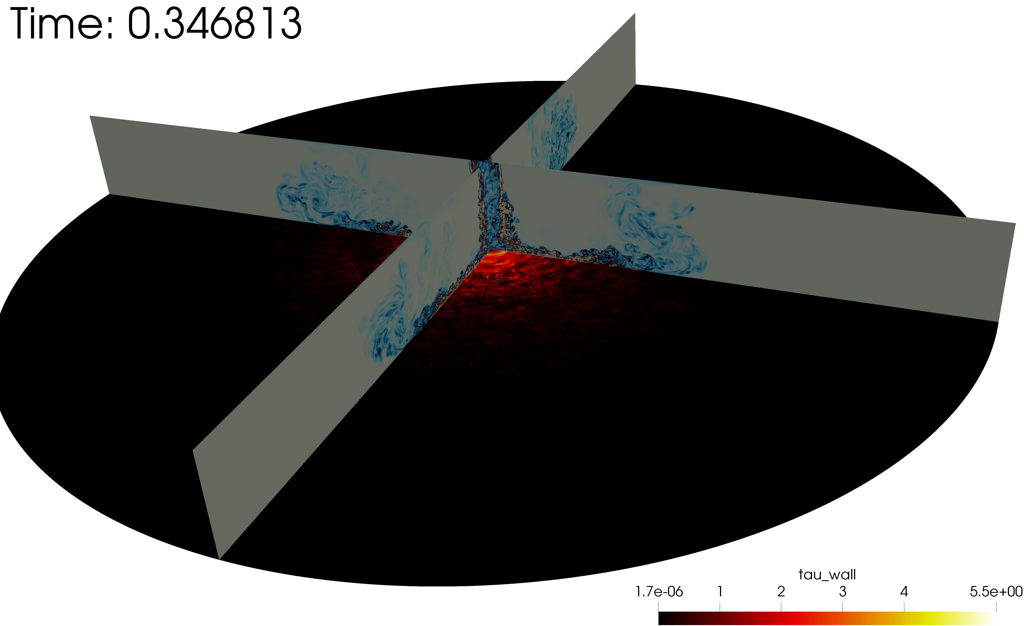

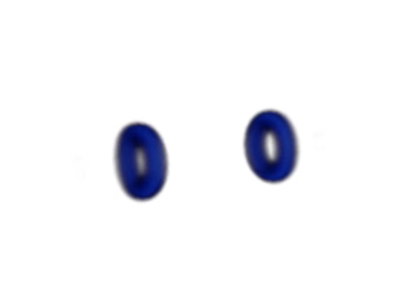
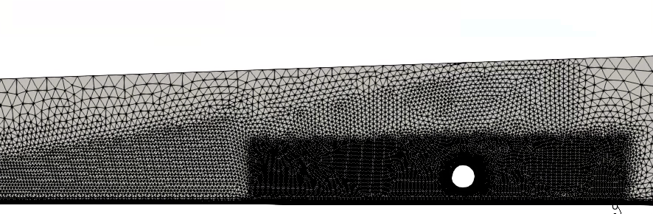
Why Sandia?
Thermal/Fluids Core Competency rests in turbulent, buoyant, multi-phase transport with UQ
Jofre, Domino, and Iaccarino, IJHT, 2019
Domino, Sakievich, Barone, Comp&F 2019
Domino, JCP 2018
Jofre, Domino, and Iaccarino, Flow T&C, 2018
Turbulent jets
Buoyant plumes/whirls
Deposition and suppression
Vortex dynamics
Quality unstructured numerics

Slide 11
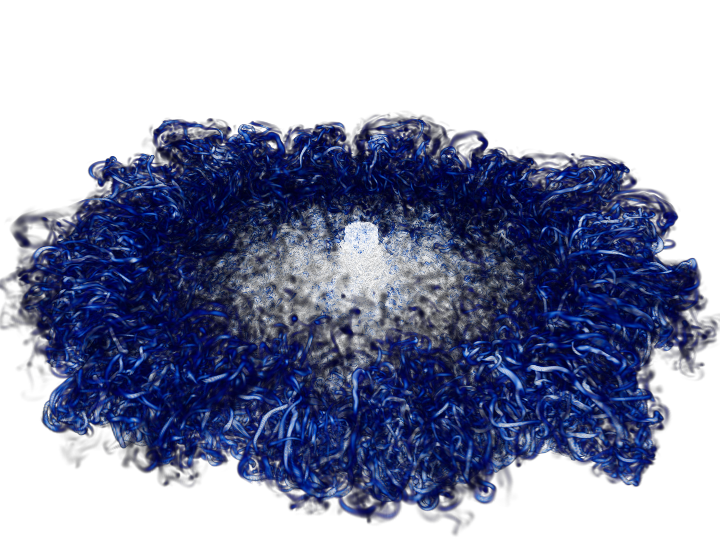
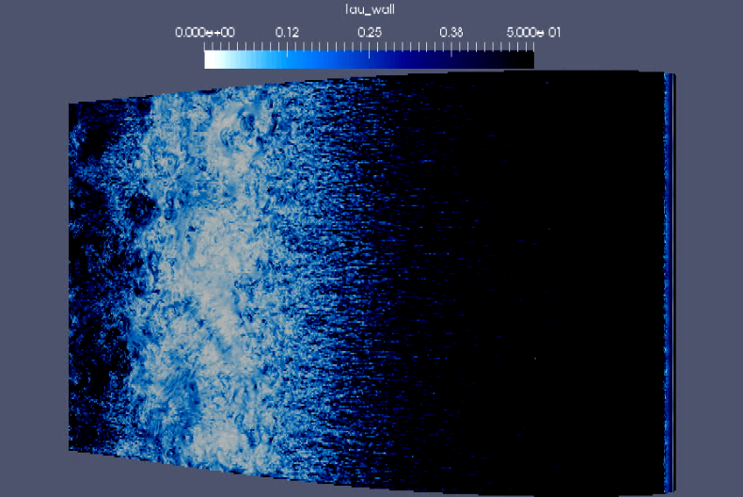
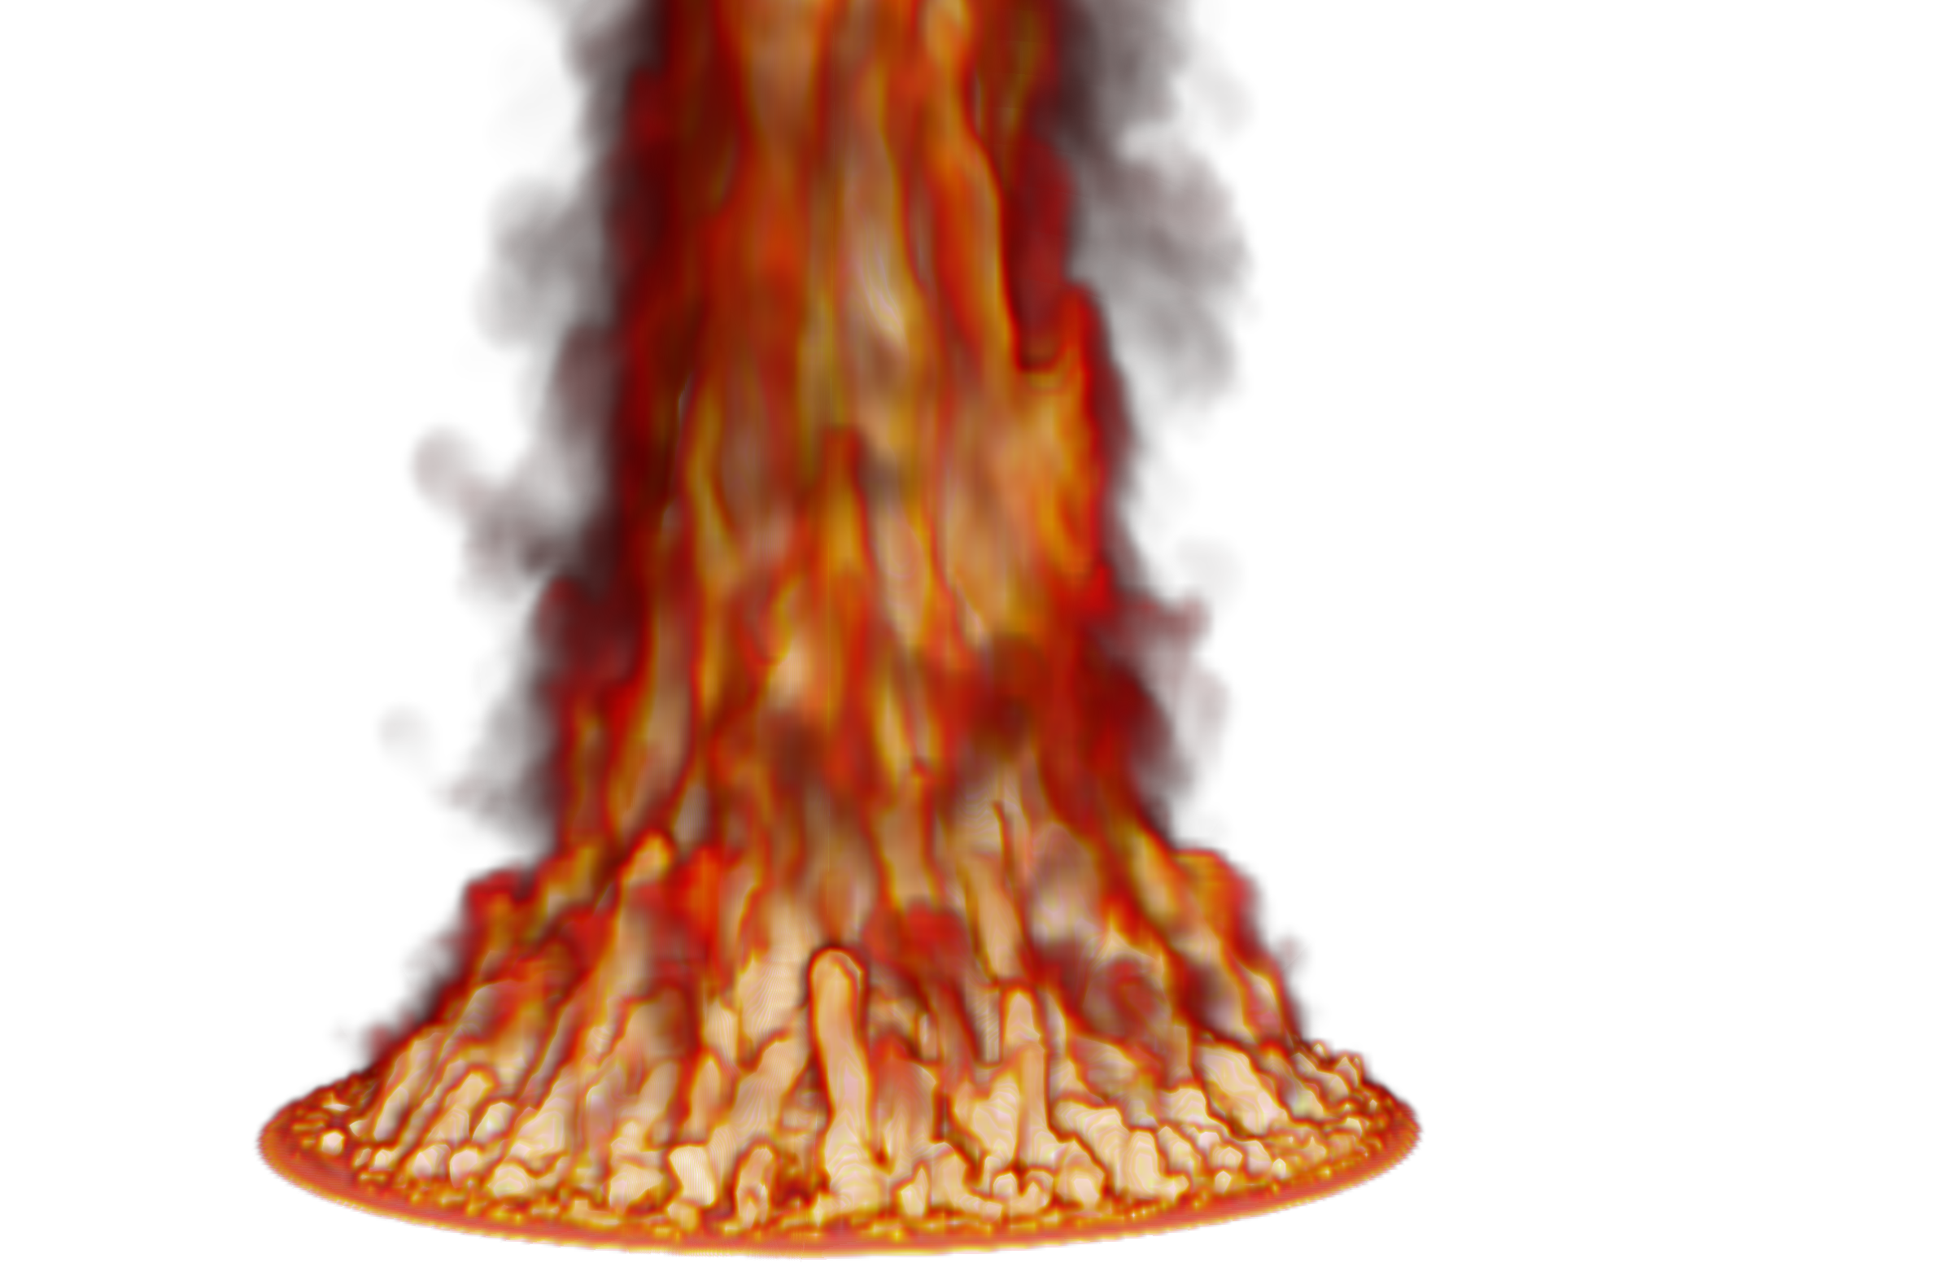
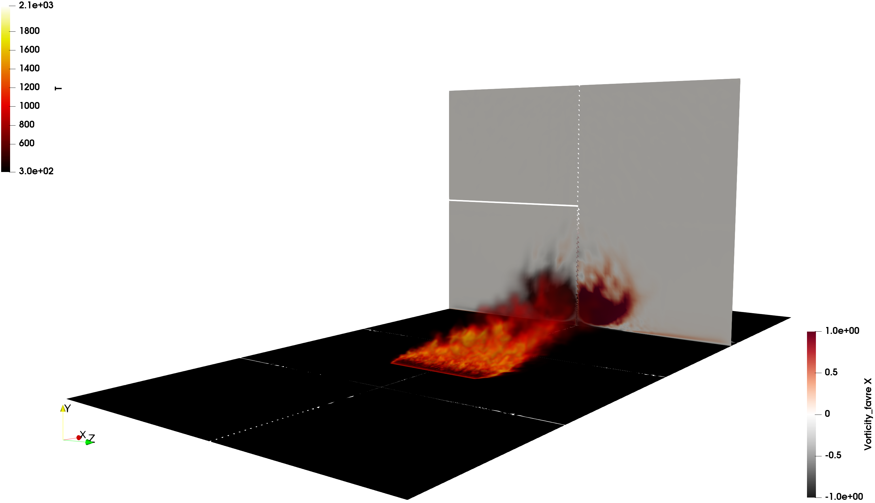

A Note on High Performance Computing
Sandia is committed to High Performance Computing (HPC) to support is science and engineering objectives: Exercised herein
O(2) billion DNS impinging jet
O(200) million multi-physics fire
O(6) billion wind energy application

Slide 12

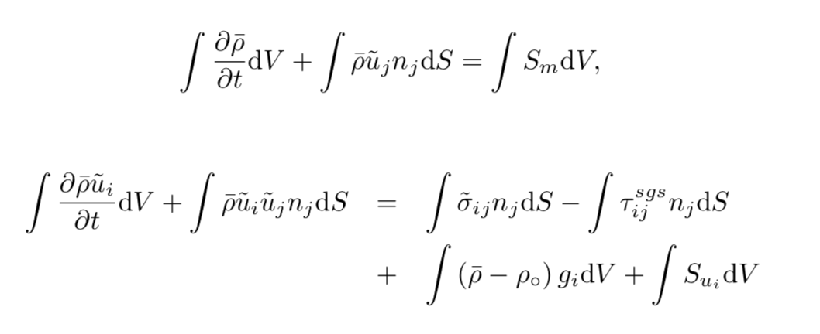
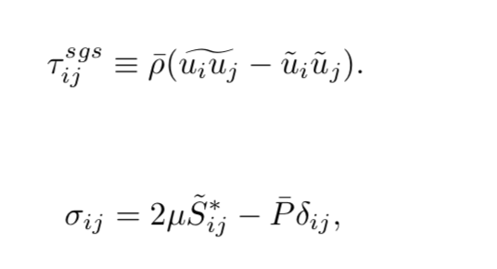
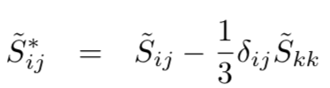
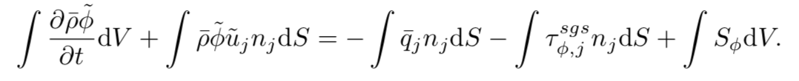
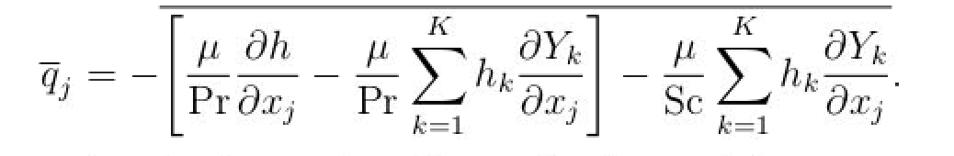
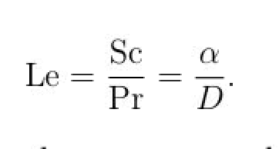
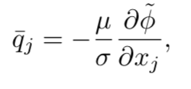
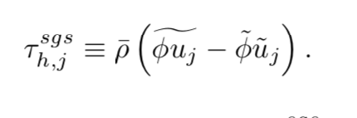
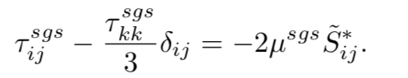
Proposed Math Model Suite (Eulerian)
Variable-density low-Mach Eulerian/point-Lagrangian multi-physics coupling; Sierra/Fuego
Large-eddy simulation-based (low-pass spatial filter); RANS supported, not considered
S_{k} represents coupling from Lagrangian evolution and represents source/sink of mass, momentum, energy, and species
Approximate incremental pressure-projection scheme
Multiple LES models supported…

Slide 13
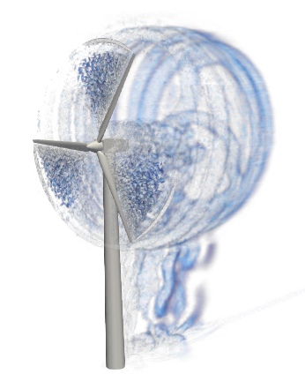
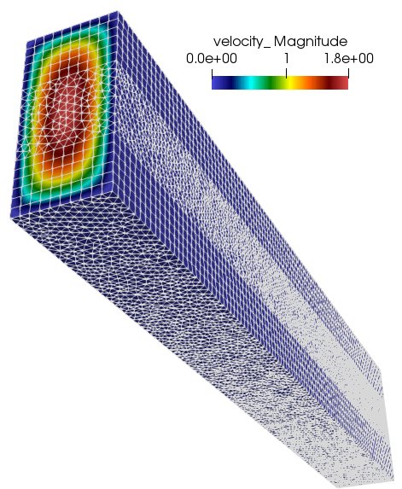
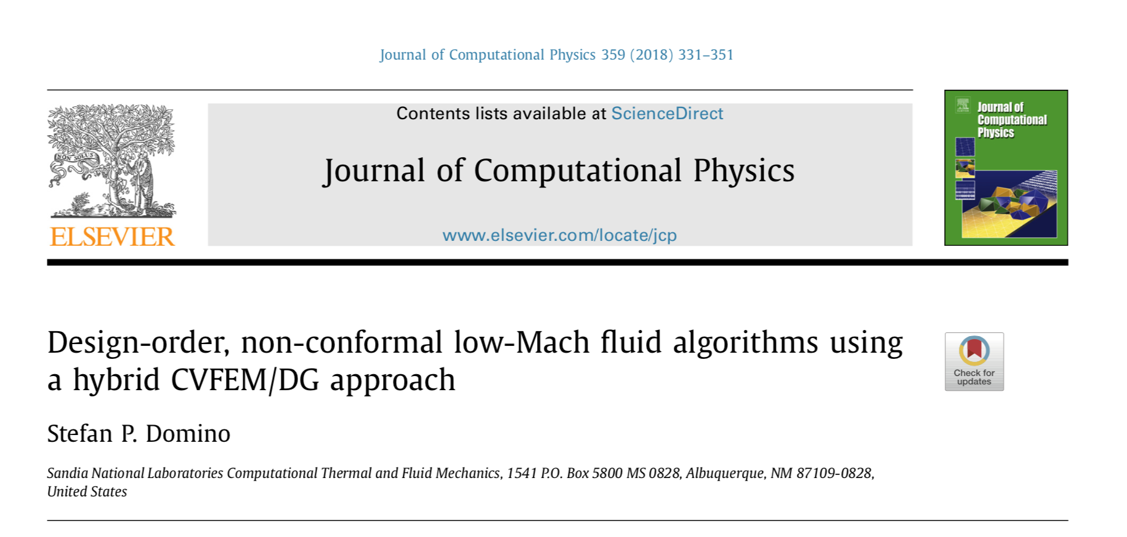
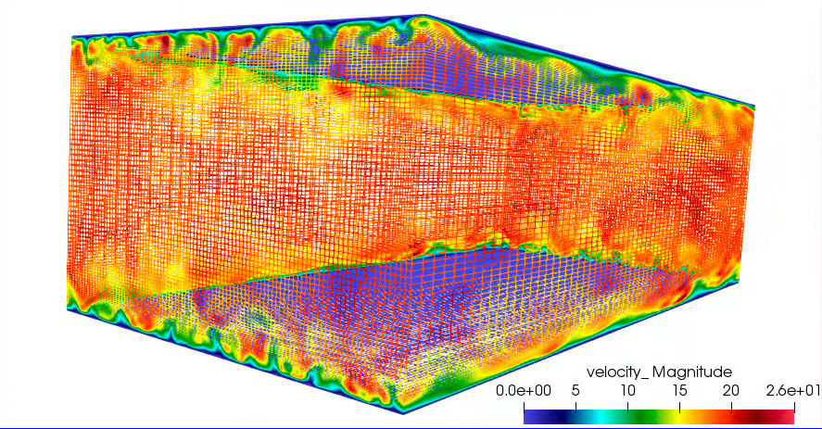
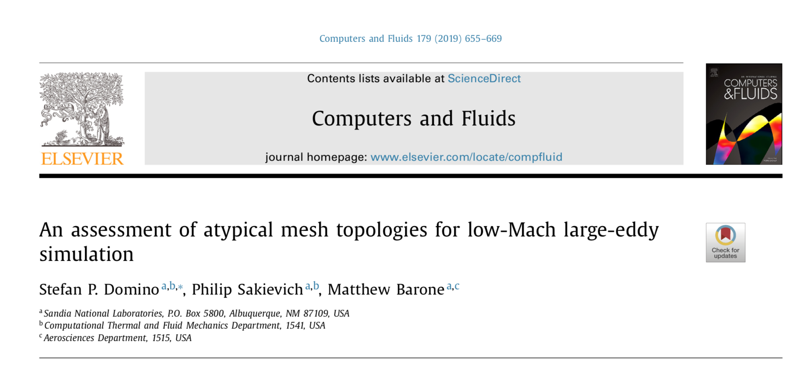
Confidence Established for Atypical Element Topos
Verification
Validation

Slide 14
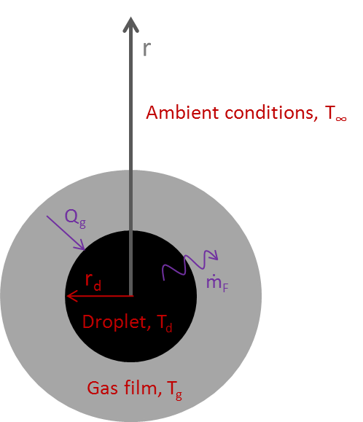
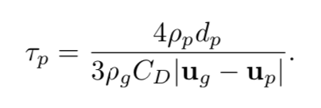
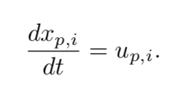
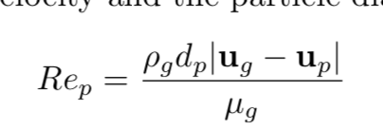
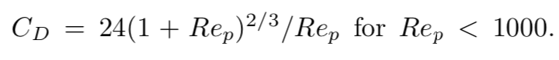
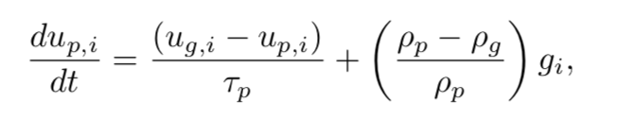
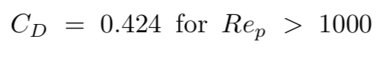
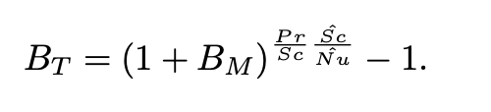
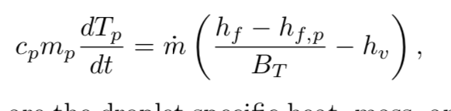
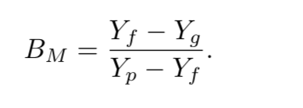
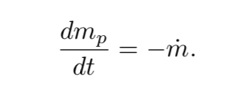
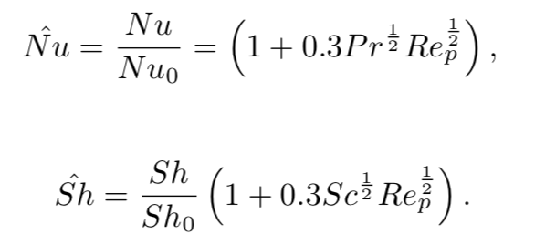
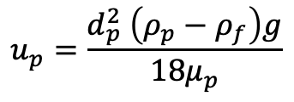
Proposed Math Model Suite (point-Lagrangian)
**
Stefan flow
Relaxation time
Spherical Lagrangian droplets
Particle Reynolds number
Circa 1950s
(Spalding, 1953)
Subgrid fluctuations
Drag coefficient; C_{D} = 24/Re_{p} provides limiting settling velocity, u_{p}
$$u_{p}=\frac{d_{p}^{2} \left(ρ_{p}−ρ_{f}\right)g}{18μ_{p}}$$
Spalding heat and mass transfer number
Raoult’s law and Clausius/Clapeyron (liquid/vapor equilibrium)
Ranz-Marshall correlation (1952)
See Fuego manual, or excellent derivation under Wikipedia: https://en.wikipedia.org/wiki/Droplet_vaporization **

Slide 15
Coupling Details
Eulerian solve is fully-implicit (BDF2); Lagrangian solve is explicit
Multi-stage stiff ODE integrator with exact or approximate (FD-based) Jacobians
For more details on implementation and verification, see the ASC Fuego theory manual: https://prod-ng.sandia.gov/techlib-noauth/access-control.cgi/2017/1710407.pdf
Lagrangian Advance (interpolation in time for fluids state)
x
x
x
x
x
x
x
x
Stick/pass/bounce
N
N+1
N+2
N+3
Stiff ODEs generally drive multiple steps (adaptive; minimum step count specification)
Droplet trajectory
accumulating mass, momentum, energy
Fluids Solve (allows for disparate mesh resolution)
Eulerian source terms
while (pIsActive) { itegrateInElem();
faceElemConnect();
communicate();
} load_balance();
Fluids fields
Fluids Mesh
Particle Mesh

Slide 16
Coupling Details
Eulerian solve is fully-implicit (BDF2); Lagrangian solve is explicit
Multi-stage stiff ODE integrator with exact or approximate (FD-based) Jacobians
For more details on implementation and verification, see the ASC Fuego theory manual: https://prod-ng.sandia.gov/techlib-noauth/access-control.cgi/2017/1710407.pdf
Lagrangian Advance (interpolation in time for fluids state)
x
x
x
x
x
x
x
x
Stick/pass/bounce
N
N+1
N+2
N+3
Stiff ODEs generally drive multiple steps (adaptive; minimum step count specification)
Droplet trajectory
accumulating mass, momentum, energy
Fluids Solve (allows for disparate mesh resolution)
Eulerian source terms
while (pIsActive) { itegrateInElem();
faceElemConnect();
communicate();
} load_balance();
Fluids fields
Fluids Mesh
Particle Mesh

Slide 17
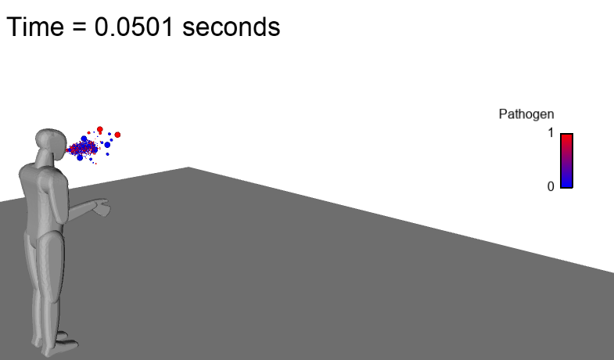
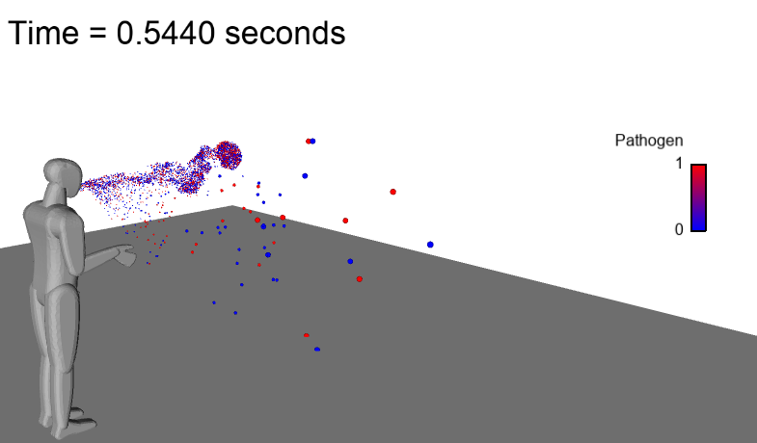
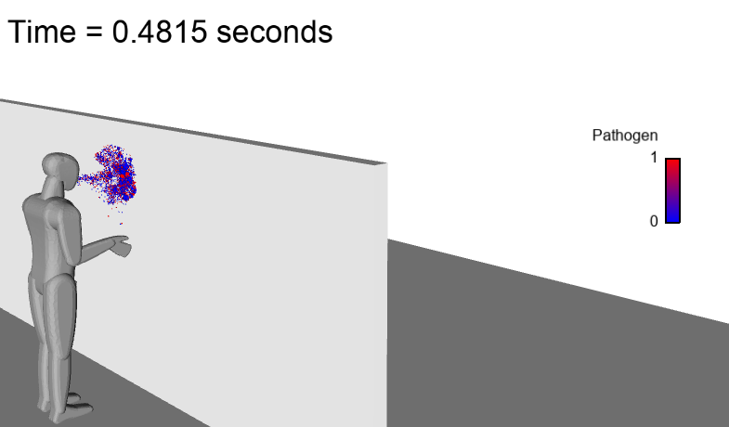


First Objective: Establish a Credible High-Fidelity Multi-physics Tool
Deploy multi-physics code capability: Sierra/Fuego low-Mach turbulent reacting flow code with point-Lagrangian coupling; credibility established for a variety of use cases
Credibility/Validation for droplet evaporation (Ranz and Marshall, 1952) and plume dynamics (Fan, 1967)
Multi-physics coughs passive breathing fluid/droplet simulations w;w/o crossflow/plexiglass

Slide 18


Established Code Credibility; Evaporation Model Validation
Ranz and Marshall, 1952 evaporation curves
Validation
D² established
Exploration,
d = f(RH, Tª)
Miami vs ABQ
50%
79%
50%
79%

Slide 19
Quiescent Modeling Assumptions: To Include or Not Include: Evaporation and Coupling to Flow Field
Large droplets (> 100 μm), regardless of modeling assumptions, deposit quickly
High crosswind velocity (10 m/s and higher) can increase deposition distance
Small droplet nuclei (low-Stokes number) are highly coupled to fluid flow
For O(1) scoping simulations, evaporation can probably be neglected iff p(d) not of interest and the majority of initial droplets of interest ~20 μm
Droplet transport should always be coupled to carrier fluid (cough, sneeze, breathing); Eulerian source terms (generally) << small
Two-way coupling/droplet tracking is safest, especially since due to low numbers, the cost for droplet tracking is very [very] low
D^{f} = 2.74μm
D^{f} = 5.4μm

Slide 20




Established Code Credibility; Turbulent Fluid Mechanics
L. Fan, Turbulent buoyant jets into stratified or flowing ambient fluids, Ph.D. thesis, California Institute of Technology (1967)
LES is viable when you can resolve the flow as models are generally simplistic
Fr
Fr 10 (~breathing)
Fr 40; uniform or stratified
Fr 40 (~coughing)
Baroclinic terms small; Nicolette, Tieszen, Black, and Domino, SAND-20056273
Buoyant instabilities low; Kyle and Sreenivasan, JCP 1993

Slide 21





Use-Case Metric(s) of Interest: Primary, Secondary Deposition/Persistence Distances
What are the quantities of interest for a science-based mod/sim study?
Primary max deposition distances
Large, initial ballistic droplets
Persistence of droplet nuclei or aerosol distances
Those droplets that evaporate and persist (with pathogen)
Droplet/Aerosol loads that drive probability of infection
wind direction (1 m/s)
Q-criterion 1 m/s
u_{z}
g_{y}

Slide 22

Nominal Cough in Quiescent Conditions
~300 million element simulation (4608 MPI ranks)
Top wall not shown
Top wall not shown
10 m/s
Classic axisymmetric jet shedding drives droplet clustering; O(0.1)cm @inflow
Primary droplet cloud in addition to secondary buoyant plumes

Slide 23
Strong Cough in Quiescent Conditions
20 m/s
Classic axisymmetric jet shedding drives droplet clustering
Primary droplet cloud in addition to secondary buoyant plumes

Slide 24






Nominal/Strong Cough in Quiescent Conditions
Nominal (Top) Strong (Bottom); R2 mesh

Slide 25


Nominal/Strong Cough in Quiescent Conditions: 120 seconds
~4 meters
Maximum primary droplet deposition approaches 4 meters
Long length- and time-scale persistence of aerosol is noted
Any appreciable crossflow advects aerosol plume out of the domain
Link to probability of infection to be established for the next use-case
~3 meters
10 m/s
~3 m
~5 meters
~4 meters
20 m/s

Slide 26

Nominal Cough in Quiescent Conditions: Plexiglass Shield
10 m/s
High- streamwise curvature impinging jet drives ring impingement clustering
Persistence of droplet nuclei is noted

Slide 27

Strong Cough in Quiescent Conditions: Plexiglass Shield
Top wall not shown
20 m/s
High- streamwise curvature impinging jet drives ring impingement clustering
Persistence of droplet nuclei is noted

Slide 28







Nominal/Strong Cough in Quiescent Conditions: Plexiglass Shield
Nominal (Top) Strong (Bottom); R2 mesh

Slide 29

Caveat: Low-Resolution Simulations Underpredict Vortex Shedding and Complex Jet Structure
Nominal cough (10 m/s); R0 nominal spacing of 1 cm in-and-around inlet
Single vortex at pulse; lack of shedding – similar in concept to a RANS result
No significant downstream vortex interaction, overly conservative

Slide 30




Caveat: Low-Resolution Simulations Underpredict Vortex Shedding and Complex Jet Structure
R0
R3

Slide 31

The Role of Protective Shrouds; Passive Breathing in Zero crossflow
“Particle Size Concentration Distribution and Influences on Exhaled Breath Particles in Mechanically Ventilated Patients”, Wan et al., 2014
Droplets persist while forming a cloud approximately 1.5 meters from source
1, 2, and 3 micron spray distribution; 120e-12 g injection over 4 seconds; sinusoidal breath of 100 cm/s
Low velocity and small droplets render direct transmission unlikely, however, as with previous simulations, droplet nuclei persist - now at low concentrations

Slide 32

The Role of Protective Shrouds; Passive Breathing in Zero crossflow
“Particle Size Concentration Distribution and Influences on Exhaled Breath Particles in Mechanically Ventilated Patients”, Wan et al., 2014
Droplets persist while forming a concentrated cloud at the protective shroud
1, 2, and 3 micron spray distribution; 120e-12 g injection over 4 seconds; sinusoidal breath of 100 cm/s
Low velocity and small droplets render direct transmission unlikely, however, as with previous simulations, droplet nuclei persist - now at low concentrations

Slide 33



Conclusions: a) Droplet Nuclei Clustering/Persistence, b) Protective Shrouds are Effective for Primary Deposition Mitigation

Slide 34


Evaluation of Open-Space Social Distance Guidelines
FY20 CARES Act “Viral Fate and Transport” multi-lab project
Understanding and mitigating SARS-CoV-2 transmission and infection risk using a science-based, mod/sim paradigm
ANL, LLNL, SNL, LANL, BNL, LBL, PNNL
Builds on Sandia’s LDRD Rapid Response effort (Domino, Pierce, Hubbard, 2020)
Project supports research/mitigation risk of SARS-CoV-2 transport/infection probability within: classrooms, buses, restaurants (courtyard), open-spaces, and in buildings
Sandia use-case presented in this seminar: Recent San Francisco open-space social distancing cases: Now with predicted risk at various downstream virtual probe locations: nominal cough (10 m/s)
San Francisco
open-space configuration
Cough modeling using local-refinement (critical for turbulent fluid mechanics) enabled by ASC NGS

Slide 35


Linking Multi-physics Mod/Sim to Probability of Infection
How can our high-fidelity physics modeling tool support probability of infection prediction?
“Development of a dose-response model for SARS coronavirus”, Watanabe et al.., Risk Anal. (2010)
, where p is the probability of infection given integrated dose, d; k is provided for a range of pathogens; ln(k) = 6.01 for SARS-CoV-1
Passive, virtual probes collect droplet/aerosol trajectories
Receptor probe(s) to establish risk
$$p\left(d\right)=1−e^{\frac{d}{k}}$$

Slide 36


Streamwise Wind Conditions: 0, 1, and 10 m/s
0, 1 and 10 m/s streamwise wind for a kneeling humanoid
Mesh spacing follows that of previous most-refined study; O(0.1) cm
Cough and droplet distribution matches standing study in quiescent conditions
Nominal 0 m/s wind condition provides similar primary droplet distances (2.8 m) and aerosol persistence (4 m)
Similar plume/aerosol structure as standing (expected)
0 m/s

Slide 37
Streamwise Wind: Towards the Back of Humanoid
1 and 10 m/s streamwise wind for a kneeling humanoid
Pulse begins after ~1 flow-through time
Look for substantial recirculation in the wake of the humanoid
Noted mechanism that drives particles towards the wall, possibly, due to turbophoresis, i.e., the effect of particles preferentially migrating towards the wall due to high wall-normal gradients of turbulence intensity
At 60 seconds, 1 m/s wind contains an active pathogen aerosol

Slide 38

Streamwise Wind: Towards the Back of Humanoid; 1 m/s

Slide 39

Streamwise Wind: Towards the Back of Humanoid; 10 m/s

Slide 40









Streamwise Wind: Towards the Back of Humanoid Comparison; Droplets
0 m/s
1 m/s
10 m/s
Droplet; ~8.1 meters
Aerosol; full domain

Slide 41


Streamwise Wind: Towards the Back of Humanoid Findings; Velocity
~ 1 m recirculation length
~ 2 m recirculation length

Slide 42









Streamwise Wind: Towards the Back of Humanoid Comparison; Temperature
0 m/s
1 m/s
10 m/s
Droplet; ~8.1 meters
Aerosol; full domain

Slide 43



Streamwise Wind: Towards the Back of Humanoid Findings; Deposition
Max primary droplet deposition extended from 2.8 m to 3.2m (1 m/s) and 8.1m (10 m/s)
Aerosol plume persists to ~4 meters (0 m/s); full domain (>16m for 1 and 10 m/s)
Larger deposition distances as wind increases due to mid-size droplets depositing
0 m/s
1 m/s
10 m/s

Slide 44

Spanwise Wind: Towards the Right of the Humanoid; Deposition, 1 m/s
Strong wind from the right suppresses streamwise deposition in favor of spanwise deposition
Aerosol plume again spans the full domain (>>5 meters)

Slide 45

Spanwise Wind: Towards the Right of the Humanoid; Deposition, 10 m/s
Strong wind from the right suppresses streamwise deposition in favor of spanwise deposition
Aerosol plume again spans the full domain (>>5 meters)

Slide 46


Spanwise Wind: Towards the Right of the Humanoid Findings; Deposition
Max primary droplet deposition reduced from 3.2 m to < 3 m (1 m/s) and from 8.1m to 2.5m (10 m/s); significant spanwise deflection (~5 m)
Aerosol plume persists to full domain (>12 m) for 1 and 10 m/s
R⁰ = 500 μm
R⁰ = 1000 μm
1 m/s
10 m/s

Slide 47
Relative Risk at 12 Locations, 0 m/s
To avoid speaking in terms of definitive infection probability, we define an infection index that is simply the particular virtual probe infection probability normalized by the maximum predicted infection probability for all probes
The infection index, therefore, allows for overviews in terms of relative risk
Standing probe location showed virtually zero risk and will not be shown
Sitting position
Level position

Slide 48
Relative Risk at 12 Locations, 1 m/s
Sitting position
Level position
Sitting position caries larger risk at down stream locations (past 1 meter)
Risk can increase for sitting position at higher distances: 12&15 m risk are greater than 9 m
Level position (mostly) monotonically decreases with increasing distance

Slide 49
Relative Risk at 12 Locations, 10 m/s
Sitting position
Level position
Sitting position caries larger risk at down stream locations (past 1 meter)
Risk can increase for sitting position at higher distances: 9&12 m risk are greater than 6 m
Risk can increase for level position at higher distances: 6 m risk is greater than 3 m

Slide 50
Inhaled Droplet Size, 1 m/s
Droplet diameter at inhalation time for three downstream virtual probe locations: sitting position
Simulations suggest inhalation events at long length- (15 m) and time-scales (60s)
Note: binning of diameter is due to initial binning of cough droplet distribution (16 in size)

Slide 51
Relative Risk: Preliminary Uncertainty Quantification (UQ)
The infection model includes parameters such as:
Receptor radius, i.e., particles crossing a virtual sphere have a 50% probability of being inhaled
Plaque Forming Units (PFU) per droplet (dominant in the virtual probe location shown below)
ln(k) parameter
Probability of deposition based on Heyder, 2004
Research Thrust: Improved UQ for each of the above should a future funding portfolio emerge
"Deposition of inhaled particles in the human respiratory tract and consequences for regional targeting in respiratory drug delivery”, Heyder, Proc. Amer. Thor. Soc 1 (4) (2004).
Six meters downstream, sitting

Slide 52
Conclusions
A multi-physics approach to model pathogen transport emanating from synthetic coughs and breathing was outlined
Credibility of the simulation tool for this application space, Sierra/Fuego, was established:
Eulerian/point-Lagrangian, variable-density (energy and species transport) turbulent, low-Mach coupling
Standing and kneeling humanoid configurations with and without a) plexiglass shielding and b) wind, outlined the dominant physics: mis-aligned velocity wrt gravity pulse buoyant jet with vortex rollup and breakdown that drives preferential aerosol transport of evaporating droplets as they transition to droplet nuclei
Simulations in open-space were linked to a probability of infection
Simulation studies demonstrate:
3 meter and beyond primary deposition distances
Long length- and time-scales for transport of aerosols in even moderate crossflow (1 m/s)

Slide 53
Acknowledgements
Funding Portfolios
Sandia Lab Directed Research and Development COVID-19 FY20 (ESRF, Witkowski)
This research was supported by the DOE Office of Science through the National Virtual Biotechnology Laboratory, a consortium of DOE national laboratories focused on response to COVID-19, with funding provided by the Coronavirus CARES Act
People
The Domino/Amann household, “Could you please hand me that cough – argh, I mean, water bottle”
LDRD Teammates: Flint Pierce (1541) and Joshua Hubbard (1514)
LDRD Oversite team: Walt Witkowski (1540) and Keith Matzen (1000)
Professor Gianluca Iaccarino (Stanford)
Professor Lydia Bourouiba (MIT)
Monica Carriere (1545)
CARES Act “Viral Fate and Transport” teammates from ANL, LLNL, SNL, LANL, BNL, LBL, PNNL
SNL Institutional HPC Team – more that 4 million CPU hours on Ghost
For More Information:
“A Multi-physics Computational Investigation of Droplet Pathogen Transport Emanating from Synthetic Coughs and Breathing”, Domino, Pierce, and Hubbard, Accepted to Atomization and Sprays, 11/2020
“A Case Study on Pathogen Transport, Deposition, Evaporation, and Transmission: Linking High-Fidelity Computational Fluid Dynamics Simulations to Probability of Infection”, Domino, submitted to International Journal of CFD, 01/13/2021
Notes:
Tsega, Computational Fluid Dynamics Modeling of Respiratory Airflow in Tracheobronchial Airways of Infant, Child, and Adult, Comp Math Meth Med, 2018

Slide 54
Extra/Supplemental Slides
Notes:
Tsega, Computational Fluid Dynamics Modeling of Respiratory Airflow in Tracheobronchial Airways of Infant, Child, and Adult, Comp Math Meth Med, 2018

Slide 55
Chosen Discretization: Control-Volume Finite Element Method (CVFEM)
A combination between the edge-based vertex-centered and FEM is the method known as Control Volume Finite Element (CVFEM) (Hex, Tet, Pyr, Wedge)
A dual mesh is constructed to obtain flux and volume quadrature locations
As with FEM, a basis is defined:
$$T\left(x_{k}\right)≈\sum_{i=1}^{npe}{N_{i}\left(x_{k}\right)T_{i}}$$
$$\frac{∂T\left(x_{k}\right)}{∂x_{j}}≈\sum_{i=1}^{npe}{{\frac{∂N_{i}\left(x_{k}\right)}{∂x_{j}}T}_{i}}$$
Integration-by-parts over test function w:
However, define a test function, w, as a piece-wise constant function (Heaviside) to be 1 inside the dual volume and 0 outside. Gradient is a Dirac-delta function:
Leading to:
A_{j}
$$\int{wρC_{p}\frac{∂T}{∂t}dV+\int{\frac{∂w}{∂x_{j}}λ\frac{∂T}{∂x_{j}}}dV−\int{w}λ\frac{∂T}{∂x_{j}}n_{j}dS=0}$$
Vol_{k}
$$\frac{∂w}{∂x_{j}}=−n_{j}δ(x_{j}−{xIP}_{j})$$
dual-volume definition
Edge-based assembles A_{j} and Vol_{k} to edges and nodes, respectively
$$\int{ρC_{p}\frac{∂T}{∂t}dV −\int{λ\frac{∂T}{∂x_{j}}n_{j}}dS=0}$$

Slide 56




Control-Volume Finite Element Method Attributes
CVFEM can be viewed as Petrov-Galerkin method
The method can also be promoted in polynomial space, see Domino, CTRSP, 2014 as a first example of low-Mach fluids algorithm – or Domino, JCP, 2018
Research Thrust: Possible higher efficiency on NGP due to increased local work)
Suitability of higher-order for LES is an open argument – especially when other errors/uncertainties exist
Rotating cube (Re 4000, RPM 3600)
P=1 (top) and P=2 (bottom)
Spectral convergence
Dual-volume for promoted quad4

Slide 57
Established Code Credibility; The Effect of Solids
Modified Ranz and Marshall, 1952 evaporation curves; 0% RH to include the effects of solids concentrations
Vapor pressure simply reduced via Raoult’s law
Minimal mass model (99.5% H₂0) primarily used in production simulations

